Slide 1

Big Mountain Ticket Review
March 3, 2021
Cierra Davis

Slide 2
Problem Identification & constraints
Set ticket price increase customer base & leverage/capitalize existing resources
Access to 105 trails
Service 11 lifts, 2 T-bars, and 1 magic carpet
Longest run 3.3 miles
Base elvation is 4,464 ft and summit is 6,817 ft with a vertical drop of 2,353

Slide 3
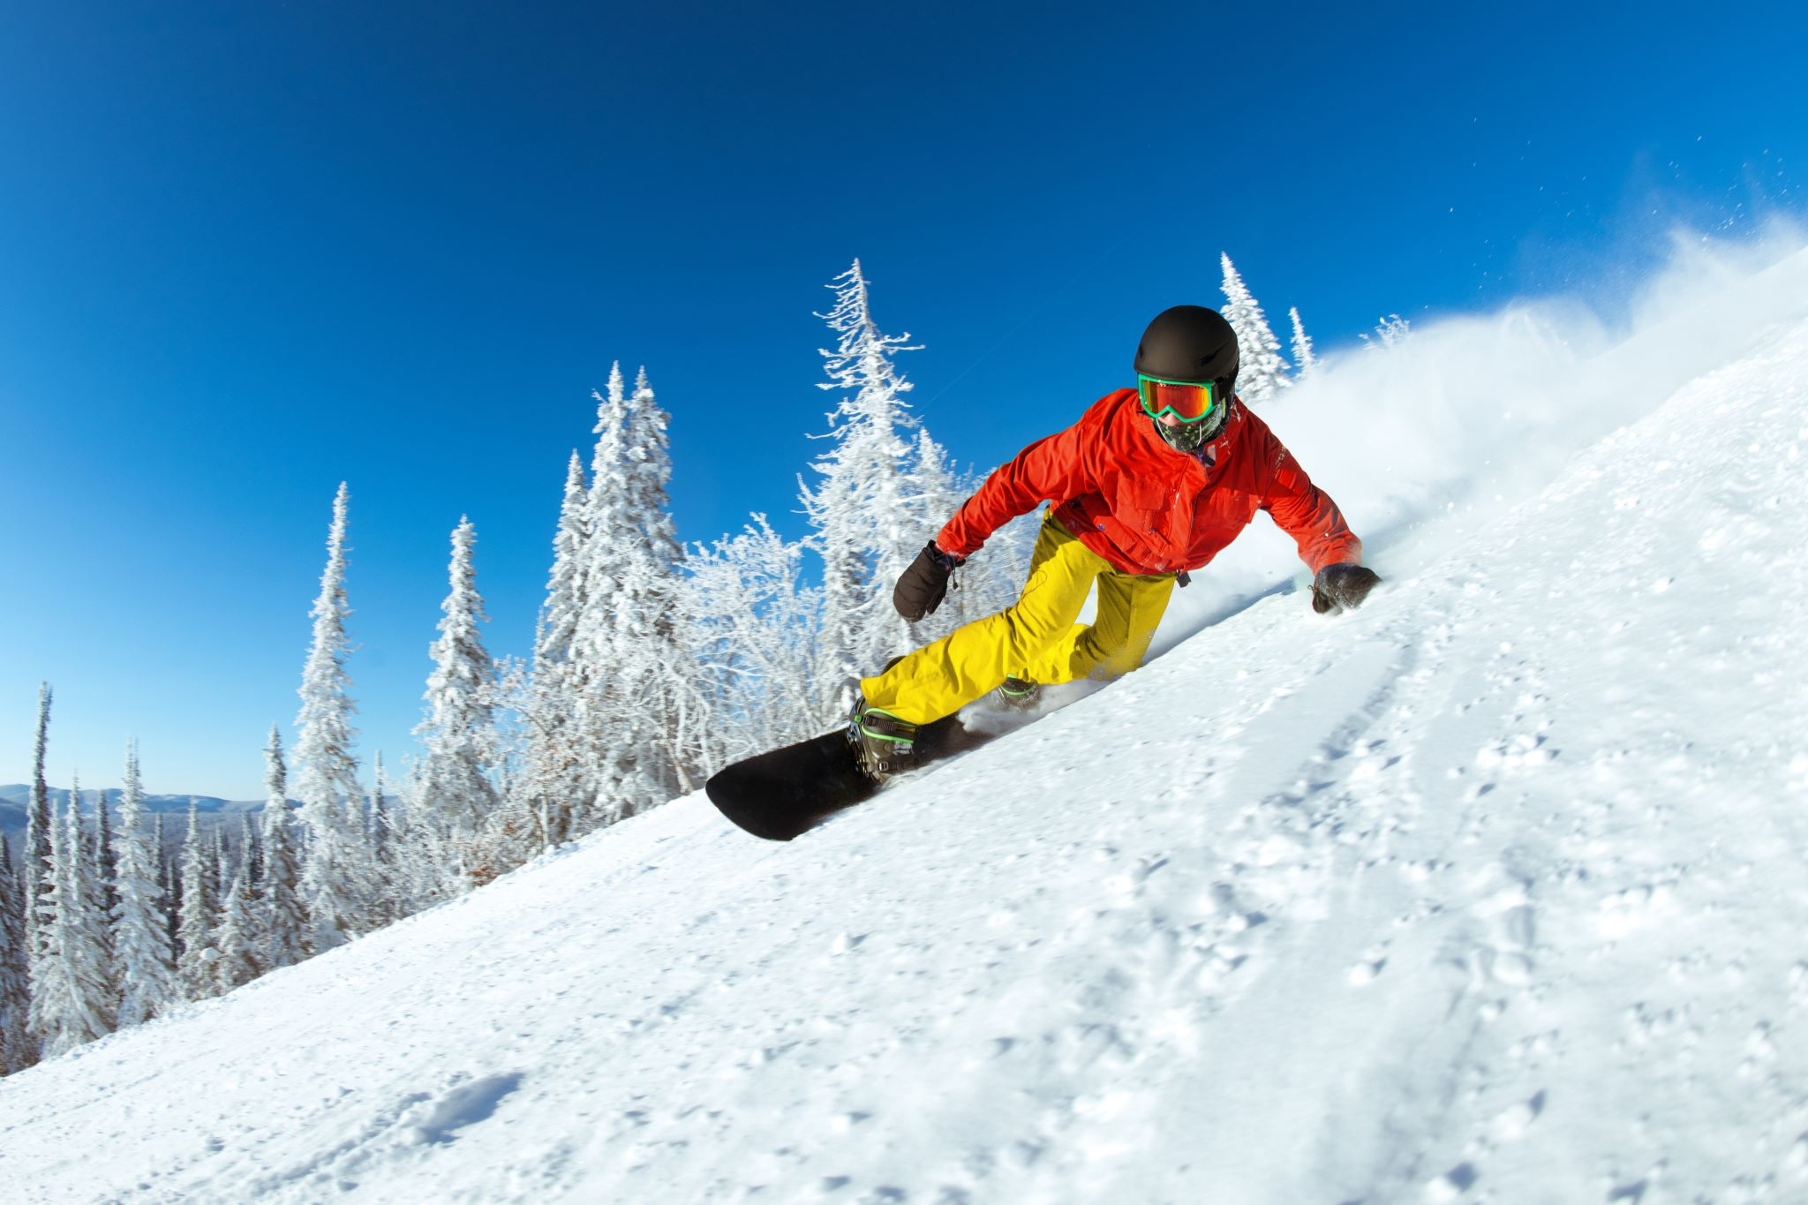
Key Features
Vertical Drop
Snow Making
Total # of Chairs
Fast Quads
Runs
Longest Run
Trams
Skiable Terrain

Slide 4
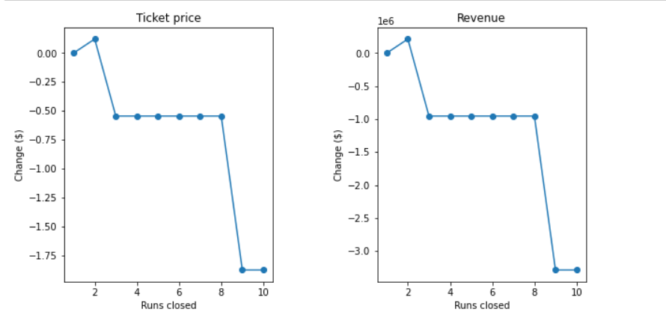
Modeling Results & Analysis
Closing 1 run makes no difference. Closing 2 reduces support for ticket price and revenue. If Big Mountain closes down 3 runs, it seems they may as well close down 8 as there's no further loss in ticket price. Increasing the closures down to 9 or more leads to a large drop.

Slide 5

Modeling Results & Analysis
Big Mountain is adding a run increasing the vertical drop by 150 feet and installing an additional chair lift.
This scenario increases support for ticket price by $8.48 .
Over the Season, the expected revenue with this addition is $14,848,485.

Slide 6
Modeling Results & Analysis
Big Mountain is adding a run increasing the vertical drop by 150 feet
Installing an additional chair lift
Adding 2 acres of snow making cover
The Results show this scenario increases support for ticket price by $9.36.
The expected amount by the end of the season is $16,386,364

Slide 7
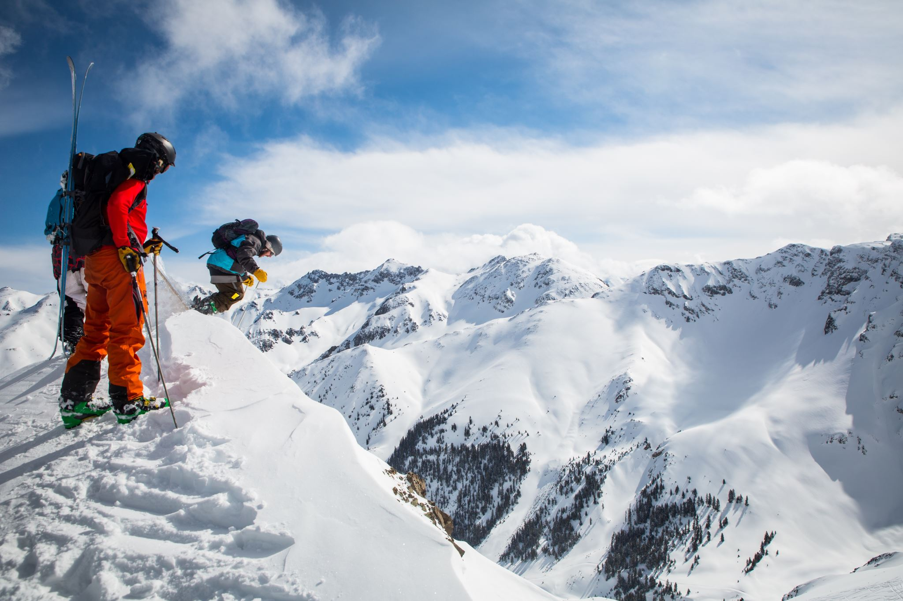
Modeling Results & Analysis
Increase the longest run to boast 3.5 miles length requiring additional 4 acres of snow coverage.
The results show no difference at all

Slide 8
Summary
Big Mountain currently charges $80 but the ticket price was modelled at $100.
Top Tier for snow making
Largest amount of skiable terrain
Highest number of total chairs
3 fast quads

